Slide 1
CSCE 313 – architectural support for os
Reading Reference: Textbook Chapter 2
Aakash Tyagi CSCE 313 Spring 2016
February 2, 2016

Slide 2
Theme of Today’s Discussion
Understand Dual-Mode Operation (User Mode versus Kernel Mode)
Cement our understanding of Architectural Support for dual mode operation and exception control flow

Slide 3
Quick Recap from Jan28 – Find Best Match for the Coffee Shop Analogy
Computer Systems
Analogy
System
Process
Interrupt
CPU
System Call
Telephone Ringing
Customer
Place an Order
Coffee Shop
Coffee Machine

Slide 4
Exceptions Recap – Find Best Match
Exception Type
Definition
Interrupt
System Call
Fault
Trap
Abort
Hard Reset
Asynchronous Event
Unintentional and Unrecoverable
Invoked by File I/O
Non-Resident Page in Memory
Breakpoint Instruction for Debug
Caused by arrival of packet from network

Slide 5
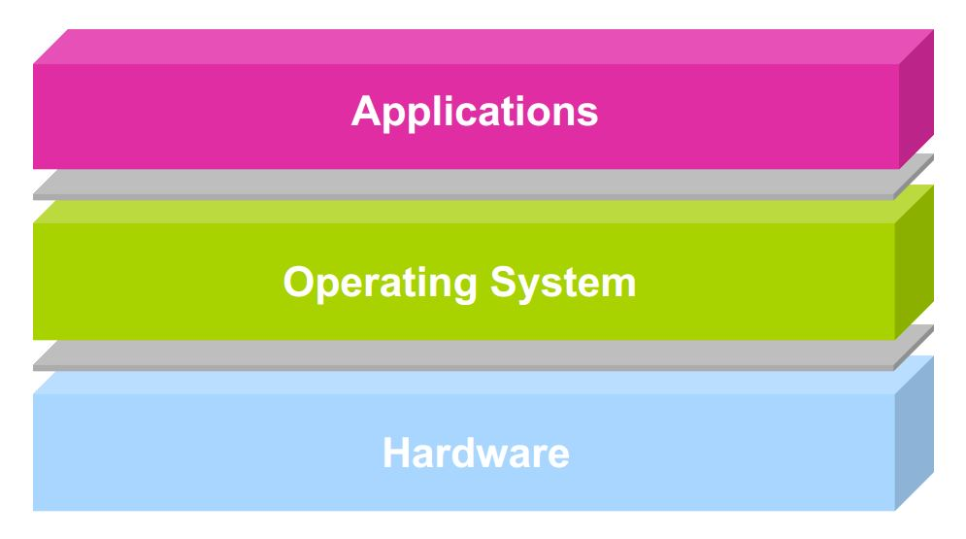
Architectural Support for OS
Operating systems mediate between applications and the physical hardware of the computer
Key goals of an OS are to enforce protection and resource sharing
If done well, applications can be oblivious to HW details

Slide 6
Challenge: Protection
Why do we execute code with restricted privileges?
Either because the code is buggy or if it might be malicious
Some examples:
A script running in a web browser
A program you just downloaded off the Internet
A program you just wrote that you haven’t tested yet

Slide 7
Challenge: Resource Sharing
How do we ensure that resources are fairly (and efficiently) shared amongst (and utilized by) user programs?
Some examples:
Many students running code on a department machine
Amazon.com servicing concurrent users
Playing a movie on a computer while typing a project report and printing a document

Slide 8
Architectural Features i.e. features we design in HW to facilitate the OS to meet some key challenges
Privileged instructions
Protection modes (user/kernel)
Memory protection mechanisms
Interrupts and exceptions
System calls
Timer (clock)
I/O control and operation
Synchronization primitives (e.g., atomic instructions)

Slide 9
Main Points for Today
Dual-mode operation: user vs. kernel
Kernel-mode: execute with complete privileges
User-mode: execute with fewer privileges
Safe control transfer
How do we switch from one mode to the other?

Slide 10
Hardware Support: Dual-Mode Operation
Kernel mode
Execution with the full privileges of the hardware
E.g. Read/write to any memory, access any I/O device, read/write any disk sector, send/receive any packet
User mode
Limited privileges
Only those granted by the operating system kernel
On the x86, mode stored in EFLAGS register
Notes:
Obviously, you need the part that has full rights to be really reliable!

Slide 11
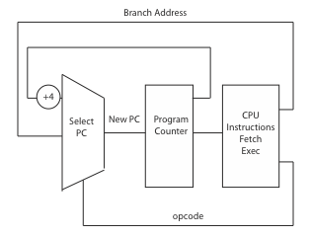
A Model of a CPU

Slide 12
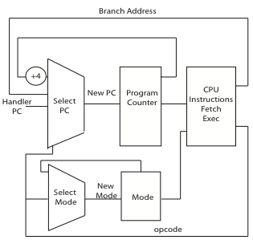
A CPU with Dual-Mode Operation

Slide 13
Hardware Support: Dual-Mode Operation
Privileged instructions
Available to kernel
Not available to user code
Limits on memory accesses
To prevent user code from overwriting the kernel or each other
Timer
To regain control from a user program in a loop

Slide 14
Privileged Instructions
A select few CPU instructions available only to the OS
Allows access to protected state
Perform global operations

Slide 15
Privileged Instructions - Examples
Only the OS should be able to
Directly access I/O devices (disks, printers..)
Allows OS to enforce security and fairness
Manipulate memory management state
E.g., page tables, protection bits, TLB entries, etc.
Adjust protected control registers
User ← → Kernel modes or Raise/Lower interrupt level
Execute the halt instruction

Slide 16
Question
What should happen if a user program attempts to execute a privileged instruction?

Slide 17
Memory Protection
Memory management hardware provides protection. Examples:
Base and limit registers
Page table pointers, Page Protection, Translation Lookaside Buffer (TLB)
Manipulating memory management hardware uses protected (privileged) instructions

Slide 18
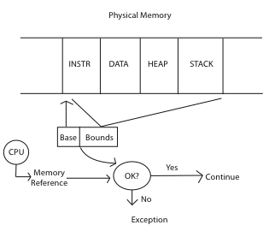
Memory Protection - Example

Slide 19
Hardware Timer
Operating system timer is a critical building block
Many resources are time-shared; e.g., CPU
Allows OS to prevent infinite loops
Fallback mechanism by which OS regains control
When timer expires, generates an interrupt
Handled by kernel, which controls resumption context
Basis for OS scheduler; more later…
Setting (and clearing) a timer is a privileged instruction

Slide 20
Question
For a “Hello world” program, the kernel must copy the string from the user program memory into the screen memory. Why must the screen’s buffer memory be protected?

Slide 21
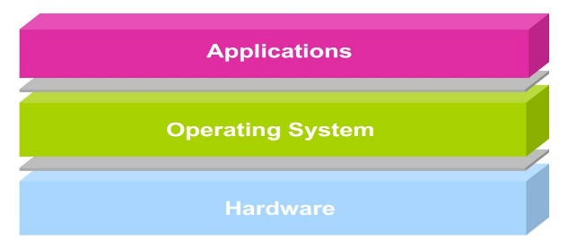
User → Kernel Mode Switch
From user-mode to kernel-mode
Interrupts
Triggered by timer and I/O devices
(Synchronous) Exceptions
Triggered by unexpected program behavior
Or malicious behavior!
System calls (traps) (aka protected procedure call)
Request by program for kernel to do some operation on its behalf
Only limited # of very carefully coded entry points

Slide 22
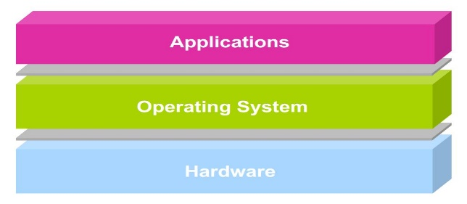
Kernel → User Mode Switch
From kernel-mode to user-mode
New process/new thread start
Jump to first instruction in program/thread
Return from interrupt, exception, system call
Resume suspended execution
Process/thread context switch
Resume some other process
User-level upcall
Asynchronous notification to user program by the kernel

Slide 23
Transfer from User to Kernel Mode – Handling Interrupts
On interrupt (x86)
Save current stack pointer
Save current program counter
Save current processor status word (condition codes)
Switch to kernel stack; put SP, PC, PSW on stack
Switch to kernel mode
Vector through interrupt table
Access the interrupt handler

Slide 24
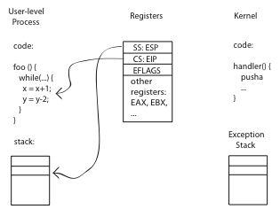
Before

Slide 25
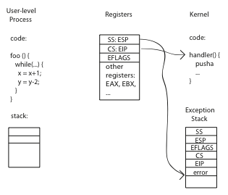
During

Slide 26
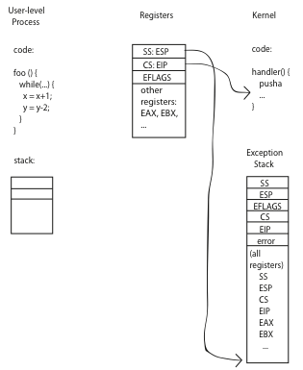
After

Slide 27
At the end of handler
Handler restores saved registers
Atomically return to interrupted process/thread
Restore program counter
Restore program stack
Restore processor status word/condition codes
Switch to user mode

Slide 28
Kernel System Call Handler
Locate arguments
In registers or on user stack
Copy arguments
From user memory into kernel memory
Protect kernel from malicious code evading checks
Validate arguments
Protect kernel from errors in user code
Copy results back
into user memory

Slide 29
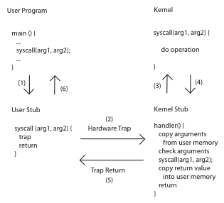
System Calls

Slide 30
Summary: User/Kernel (Privileged) Mode
User Mode
interrupt
FP exception
syscall
rtn
FP Exception error
rfi
Kernel Mode
exit
exec
Limited HW access
Full HW access
Notes:
Processor routinely checks for interrupts and if one is logged, it goes back to save the state of the process it is executing and enters the kernel to service the interrupt. The service is done by entering a interrupt vector table which contains the address of the specific interrupt service routine. Once the routine is serviced the kernel gives control back to the user process.
In multiprocessor systems, only one processor has to service the interrupt from an external device.
What happens when you move a mouse pointer? Each move or point or click registers as an interrupt which is noticed by the processor which moves the control back to the Kernel to service the interrupt routine and that shows up as an action to its associated process (e.g. move of mouse pointer in the active window, or highlight of a word selected, etc.)
An alternative to Interrupt would be “polling” where the Kernel would go in a round-robin fashion to check the status of each device to see if they have an interrupt.

Slide 31
Example: Web Server (Revisited)
syscall
syscall
syscall
RTU
RTU
wait
wait
interrupt
interrupt

Slide 32
Today’s Learnings
Architectural support for user and kernel modes in CPU execution, especially
Privileged Instructions
Protection
Interrupt/System Call handling

Slide 33
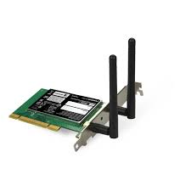



Next Lecture
Process and Programming Interface
user2
user3
user1
user2
user3
user4
user1
user4
Application Programs/Processes
System calls,
Exceptions
return
System calls,
Exceptions
Privileged
Operations
Processor
Memory
INT
Character O/P
Bock I/O
storage

